Slide 1
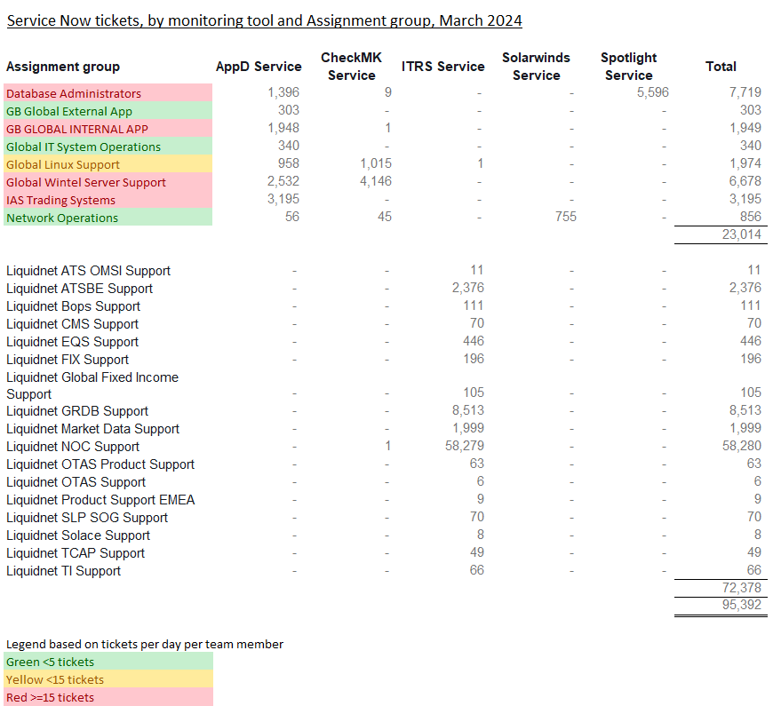
Event Trends / Noise Reduction Noise reduction is a pre-requisite to fast reaction times.
Noise Reduction Strategy
- Each team must be responsible and accountable for their own noise reduction / fine tuning
- Categorise and Prioritise events, drop some types of events that do not require immediate human action
- Stop alerting on non-Production
- Stop duplicate alerts AppD /CheckMK
- Fine tune performance thresholds to reduce transient or false alerts
- Work on chronic issues
- Continuous Improvement / Gardening

Slide 2
The plan
Each team is responsible for reducing the Noise around False alerting and Service Now tickets requiring no action.
Progress will be reported on a monthly basis.
Initial focus will be on the following queues
IAS Trading / EAS / Wintel Server Support and Database Administrators
Phase 2 will also include
Linux Support / GB Global Internal App
Why can’t we remove false alerts completely?
False alerts can be generated for a wide variety of reasons, such as:
P1 / P2 Incidents will always generate multiple tickets and, our focus will be on restoring service, not necessarily disabling alert policies in AppDynamics
Servers losing communication with the AppDynamics controller
Emergency Break Fix work taking place
Midweek code deployments
One incident creating multiple tickets
Network blips that auto-recover
No ability for AppDynamics to automatically close a ticket in Service Now when a condition clears
The above are just some examples as to why the number of incidents generated in Service Now will always be variable

Slide 3

IAS – Monitoring Review
IAS have launched a review of the monitoring configuration we employ across the application estate we are responsible for. This review is taking place in an effort to reduce the overall number of tickets we receive that do not require investigation / resolution and also to allow us to focus on quality of the information contained in the ticket, aiding the learning process for all members of the team.
What is the Problem?
IAS receive thousands of tickets each month into the ‘IAS Trading Systems’ queue in Service Now. A significant proportion of these require no action as they are generated during known maintenance windows and are, closed without investigation. This leaves IAS open to potentially closing valid alerts, introducing risk to the business. The sheer quantity of alerts we receive however, makes proper investigation of each alert impossible to achieve in any reasonable timeframe.
When tickets are closed, we frequently see close notes such as ‘Caused by CPU spike’, with no further explanation of what caused the spike. Equally, we will see close notes such as ‘due to weekend maintenance’ when in fact, the issue was nothing of the sort.
How do we intend to tackle this issue?
We have implemented a phased approach in order to deal with these tickets.
Phase 1: Get the overall number of erroneously generated tickets down using all available means
Adding Alert Suppressions into AppDynamics, omitting policies from sending alerts during periods of known maintenance or inactivity on the platform eg; TMM will not send any alerts between 00:00 Saturday and 14:00 Sunday. Marker will not send any alerts during the same period in addition to between 18:00 and 00:00 Monday to Friday, as it is not used in the US
Reviewing alerts daily, seeing what we actually have generated on a daily basis, then evaluating whether these alerts are really necessary ie; Do they need to be acted upon? If not, we have set up alert suppressions or changed rule configuration to omit false negatives
Perform trend analysis on the numbers of tickets generated per day (Tuesday vs Tuesday) and week by week to try and catch any outlying error reporting that we do not need to action
Removing rules from policies so that they may flag on a dashboard, but not generate tickets. This is useful in the event of a database CPU spike or similar, which we cannot resolve but may need to know about should other issues manifest at similar times
Feedback changes to Development / Product Owners to advise them what we are doing, why and asking them to ensure these changes are reflected in future ‘Monitoring by Code’ changes that are implemented

Slide 4
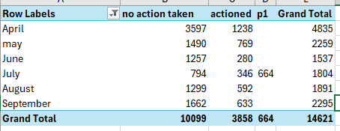
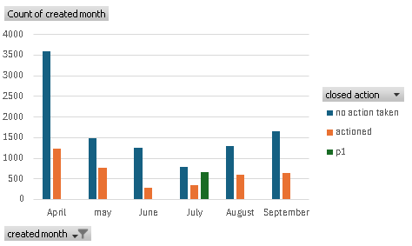
IAS – Monitoring Review
Phase 2: Focus on Quality
All tickets are to be closed using the correct ‘Close Code’ in Service Now. This is not something that can be automated and will involve an ongoing review process to ensure this is happening
Tickets are to have clear, concise information added to the Close Notes section eg; instead of using the phrase ‘CPU Spike’, we need to detail what caused the CPU spike, what was investigated to ascertain the offending process causing the spike and how it was dealt with?
Make sure the ticket reflects the correct application, application instance, regions affected. This is designed to enable trend analysis and for us to identify the heavy hitting systems, allowing resource to be directed according to need
When introducing a new application to the estate, monitoring is to be implemented on a ‘soft live’ basis, whereby no integration with Service Now will take place until initial teething issues have been identified and ironed out in what we’re monitoring, and how
How are we progressing?
The review started at the beginning of May, using April 2024 figures as our benchmark. Phase 1 is now complete on the IAS trading queue which can be seen from the graphs to the right which show a significant reduction month on month since the reduction of alerts task force began in May.
We were taking action on circa 20% of tickets generated
We have decreased the number of tickets generated by 50% by following the steps outlined in Phase 1 of this review
We are also in the process of getting the SNOW team to create a new closure code- investigated and found to be no further action required. We will then expect the actioned figure to increase as this would cover alerts such as drilling down on the type of error message to identify if it is known error already raised up to L3 or closely monitor the message spool count until violation ends to ensure messages are getting consumed
664 tickets generated on 19th July during the P1 crowdstrike outage which has distorted our July figures
September ticket count increased by 20%, the task force team will start running weekly calls to identify the top offenders and put a plan in place to reduce the false alerts again

Slide 5
IAS – Monitoring Review
When do we expect this work to be completed?
Whilst we expect this to be an ongoing body of work, we believe we will show significant differences in the numbers of tickets generated in total, in addition to enhancing the quality of the information contained therein by the end of June 2024.
The initial work has been done in the EMEA region and we will involve the team in APAC when we have shown further progress on the strategic application stack, allowing them to follow the same steps for the legacy estate.
We are unable to put a target on exactly how many tickets we will eliminate by these actions but are satisfied that the number will be significant and will enable us to provide better quality data to the business.
The total reduction will of course be dictated by new systems being brought into the IAS area and, any gaps that arise as part of this review.
Why can’t we remove false alerts completely?
False alerts can be generated for a wide variety of reasons, such as:
P1 / P2 Incidents will always generate multiple tickets and, our focus will be on restoring service, not necessarily disabling alert policies in AppDynamics
Servers losing communication with the AppDynamics controller
Emergency Break Fix work taking place
Midweek code deployments
One incident creating multiple tickets
Network blips that auto-recover
No ability for AppDynamics to automatically close a ticket in Service Now when a condition clears
The above are just some examples as to why the number of incidents generated in Service Now will always be variable
Next Steps
All work that has taken place has been on the ‘IAS Trading Systems’ queue. Once Phase 1 has been completed and we have moved to ‘focus on quality’ for IAS Trading Systems, we will commence Phase 1 on the ‘GB GLOBAL INTERNAL APP’ queue, which serves the legacy ICAP stack of systems including GUIBOS, ICAP TMS, Datatec etc
This will require input from all regions. Lessons learned from the IAS Trading Systems queue will be communicated before the process commences to all Global team members, with a specific focus on those in Manila.

Slide 6
IAS – Monitoring Review
How have these statistics been obtained?
Using report filters in Service Now, related to the IAS Trading Systems queue, we have ascertained that for 2023;
The total number for Service Now tickets raised for was 43481
23031 were closed with the code ‘No Action Required’, ‘False Alert’ or ‘Cancelled by Caller’
9323 tickets were duplicates. This has been ascertained by omitting rows with the Updated Time, Assigned To and Closed Notes where they are identical
1852 were closed with the notes ‘No Longer Violating’
724 reference ‘End of Day’ in the close notes
119 reference ‘Weekly Restart’ in the close notes
This leaves a total
of 8432 actionable alerts

Slide 7
EAS – Monitoring Review
Known/Identified Contributors for EAS alerts causing noise
As part of our SOP, we assess each alerts/incidents upon receipt to segregate actionable alerts from false or ignorable alerts and leverage the SNOW close code for this purpose.
Ignorable / False Alerts:
APPD Controller issue or network connectivity issues impacting APPD Controller.
Alerts that occurred during maintenance period.
Scheduled events such as Windows patching, Application upgrades/releases
Special events such as DR Testing.
Recurring Actionable alerts:
Memory spike issues
CPU spike
Disk Space issues
Service or Process failures
Connection count below the threshold / disconnection count above the threshold
Error events in the logs
Heart-beat issues (i.e process/service hanging, lost connection, etc)

Slide 8

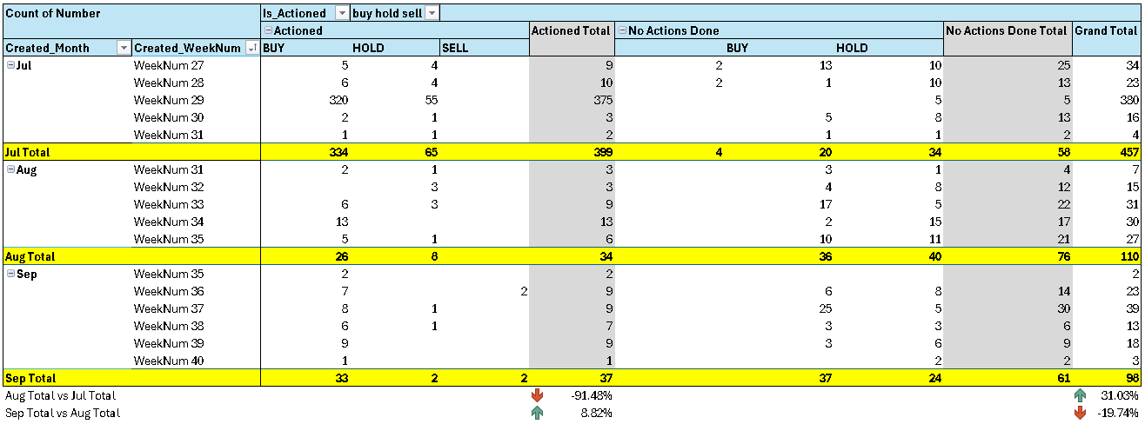
Highlights as of September 2024:
DECREASED NON-ACTIONABLE ALERTS
Non-actionable or ignorable APPD ticket volume has decreased by 19.74% for the month of September in reference to August’ “No Actions Done” alert volume.
Actionable vs Ignorable/Non-actionable Alerts as of September 2024 :
WeekNum consideration: each week begins on a Monday and ends on a Sunday

Slide 9
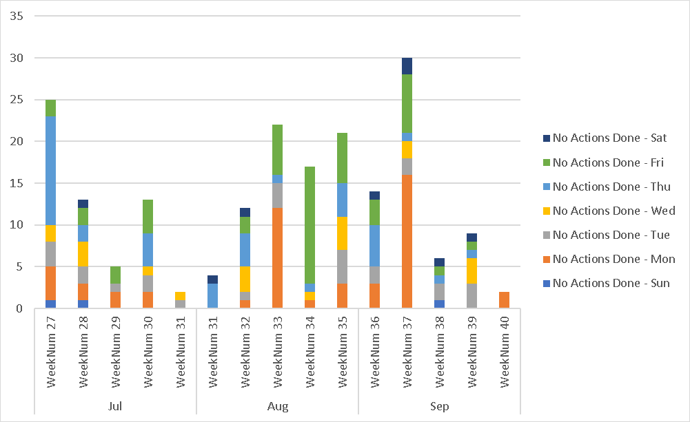
Ignorable/Non-actionable Alerts from the last 3 months
Highlights as of September 2024:
The spike in "no actions done" alerts during Week 37 is due to a missing logs issue in Appd analytics, which triggered 13 heartbeat alerts.

Slide 10
Highlights as of September 2024:
SLIGHTLY INCREASED ACTIONABLE ALERTS
Actionable alerts have slightly increased by 8.82% in September.
Apart from team’s continued effort to work on the permanent remediation of our repetitive alerts, we are also doing a regular weekly review of our tickets via our Weekly Stability Forum. On this forum, we are regularly checking our ticket quality such as:
Close code’s proper usage
Close notes should align with the close code (i.e if the close code is False Alert, the close notes must have the details explaining why it was closed as false alert).
Incorrect IT system tagging
Actionable vs Ignorable/Non-actionable Alerts as of September 2024 :
WeekNum consideration: each week begins on a Monday and ends on a Sunday

Slide 11
Ignorable/Non-actionable Alerts from the last 3 months
Highlights as of September 2024:
WEEKEND ALERT REDUCTION
Weekend alerts have been significantly reduced after amending APPD Policies to just send us notification emails for weekend failures/alerts instead of raising individual ServiceNow Ticket.
For the month of September, we have received a total of 6 “no actions done” APPD alerts that triggered on a weekend as opposed to August’ volume which is only 2.
Created_Month | Created_Day | Actioned | No Actions Done | Grand Total
Jul | Sun | 1 | 2 | 3
 | Sat |  | 1 | 1
Jul Total |  | 1 | 3 | 4
Aug | Sat | 4 | 2 | 6
Aug Total |  | 4 | 2 | 6
Sep | Sun | 2 | 1 | 3
 | Sat | 3 | 5 | 8
Sep Total |  | 5 | 6 | 11

Slide 12
Weekend “no actions done” Alerts
Highlights as of September 2024:
WEEKEND ALERT REDUCTION
Top Contributors (No Actions Done)
Alteryx : 2
- These are disk space alerts from the Wintel team’s monitoring. We’ve added this to our list of repetitive alerts that need RCA and a long-term fix.
Lisa ETD: 2
- These are node availability alerts resulting from windows patching activity. We’ve already disabled the ticket alerts for this one but have kept the email alerts active , as EAS’ coverage is only from Monday to Friday.

Slide 13
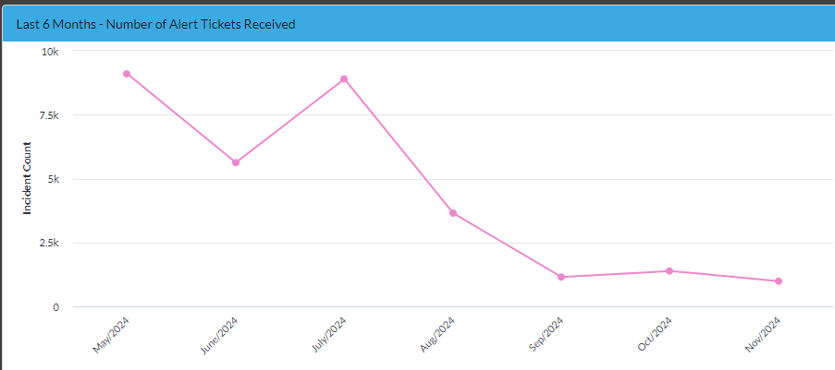
Wintel – Monitoring Review
Wintel’s monitoring noise stems from two automated alerts from CheckMK and Appd.
What is the Problem?
Lack of needed fine tuning with the monitoring tools has led to an increased amount of non-actionable noise that negatively impacts teams’ ability to respond to alerts.
Wintel Tickets continue trending downward as the team monitors and fine-tune incoming alerts. The six-month graph below shows an 83% reduction in alert volume

Slide 14
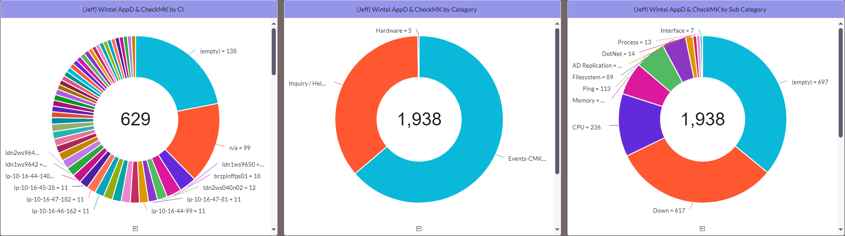
Wintel – Monitoring Review
Approach: Identify the top Talkers: The following action has been applied
Setup a dashboard that will address top talker identification - Complete
Peruse tickets to have consistent categorization for better noise identification – Tickets coming in are uncategorized, which adds a layer of difficulty in identifying its source, and categorizing these incoming tickets has a dependency on other stakeholders which Wintel is perusing. - Ongoing
Schedule weekly ticket noise analysis - Ongoing
Create action plans on identified noise and execute them:
Disable Active Directory Alerts - Done
Adjusted Availability Alerts Ticket - Done

Slide 15
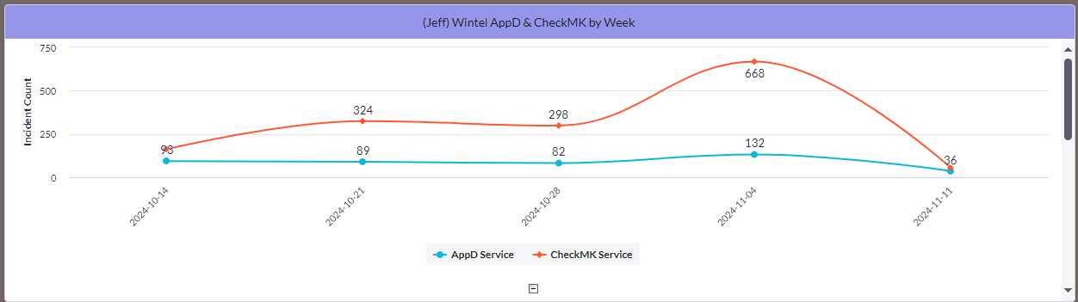
Wintel – Monitoring Review
How Are We Progressing?
Adjust server availability health threshold to reduce ticket generation – Complete
Identify application alerts that are driving noise (Active Directory Monitoring, Availability Alerts) - Complete
Fine Tune CheckMK Alerts to eliminate non-actionable alerts - Complete
Established a process to turn off CheckMK/alerting during patching and site-wide activity - Complete
Roll Out The new CheckMK monitoring platform - Ongoing

Slide 16
Wintel – Monitoring Review
September Progress:
56% reduction of Wintel alerts from August to September
Deployment of Checkmk continues to progress.
Weekly ticket review is ongoing to reduce the number of tickets further.

Slide 17
DBA – Monitoring Review
Approach: Identify the top Talkers: The following action has been applied
- Each team must be responsible and accountable for their own noise reduction / fine tuning
- Categorise and Prioritise events, drop some types of events that do not require immediate human action
- Stop alerting on non-Production
- Stop duplicate alerts AppD /CheckMK
- Fine tune performance thresholds to reduce transient or false alerts
- Work on chronic issues
- Continuous Improvement / Gardening
Current Progress:
As we continue to fine-tune availability alerts, we have so far achieved a reduction of 5.39% month on month August – September 2024, excluding AppD. The trend for Spotlight and OEM are trending downwards from August to September. However August and September data were skewed by AppD tickets which AppD team is investigating for the cause of the spike.
To Date focus has been on Removing Non-Prod alerting and fine-tuning alerting threshold

Slide 18
DBA – Monitoring Review
DBA monitoring noise stems from 3 Sources Spotlight, OEM and AppD.
What is the Problem?
Lack of needed fine tuning with the monitoring tools has led to an increased amount of non-actionable noise that negatively impacts teams’ ability to respond to alerts.
Month of September
There was an increase of 7.13% in AppD alerts comparing to August. Graham Colgate from the AppD team has investigated as per RQ6206075 and confirmed there were gaps in metrics data in AppD. Graham has raised it with AppDynamic to investigate further.
In September we have two patching days – 7th Sept and 14th Sept. Alerts generated from these days have been excluded from the stats.
Tickets for Spotlight and OEM are trending downwards from August to September as we continue to streamline the metrics.

